Slide 1
CLASS - 10
SUBJECT - SCIENCE
CHAPTER – 6
LIFE PROCESSES

Slide 2
INTRODUCTION
What are life processes
Nutrition
Types of nutrition
Autotrophic
Heterotrophic
Nutrition in plants
Nutrition in amoeba
Nutrition in human beings

Slide 3
LIFE PROCESSES
Life processes are the basic processes in living organisms which are necessary for maintaining their life.
The basic life processes are – Nutrition, Respiration, Transportation, and Excretion.

Slide 4
NUTRITION
Food is essential for all living organisms. It enables organisms–
To build their bodies
To grow
To repair damaged parts of the body
To provide energy for various activities

Slide 5
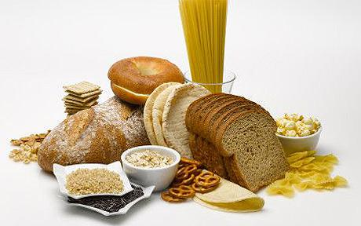
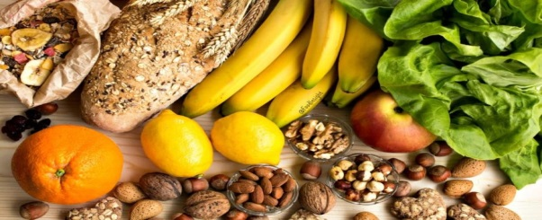
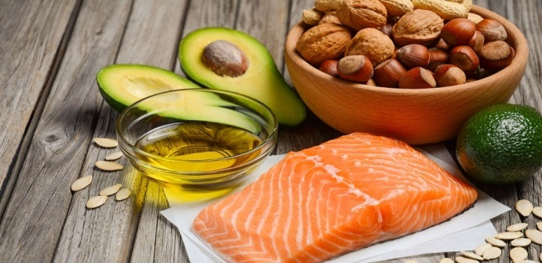
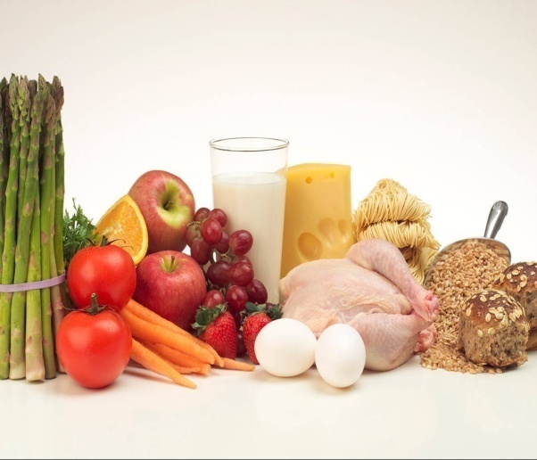
CARBOHYDRATES
VITAMINS,
MINERALS
These components of food are known as nutrients
The uptake of nutrients and its utilization by the body is called nutrition
FATS
PROTEINS

Slide 6
NUTRITION
There are two modes of nutrition:
Autotrophic nutrition
Heterotrophic nutrition

Slide 7
NUTRITION
The mode of nutrition in which organisms make food themselves from simple substances, is called autotrophic nutrition.

Slide 8
NUTRITION
The mode of nutrition in which organisms take in food prepared by plants, is called heterotrophic nutrition.
Animals are called heterotrophs because they depend on plants for their food

Slide 9
NUTRITION
IN
PLANTS
Plants prepare their food with the help of certain raw materials.
What are the raw materials needed by plants to make food?
-Water
-Carbon dioxide
-Sunlight
-Minerals
-Chlorophyll

Slide 10
NUTRITION IN PLANTS
The process by which plants prepare their food by using these raw materials is called photosynthesis
Leaves are the places where food is prepared by plants.
Water and minerals are present in soil.
They are absorbed by the roots
Water and minerals are transported to the leaves by the vessels which run like pipes throughout the root, the stem, the branches and the leaves.

Slide 11
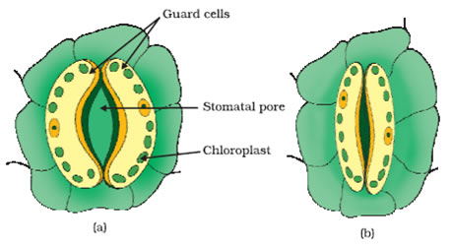
NUTRITION IN PLANTS
There are tiny pores present on the surface of leaves called stomata.
* These pores are surrounded by guard cells.
* These pores take carbon dioxide present in the atmosphere.
* Stomata helps in exchange of gases and transpiration

Slide 12
NUTRITION IN PLANTS
A substance called chlorophyll is present in the leaves of plants.
It is a green color pigment which provide green color to the leaves
It helps the leaves to capture the energy of sunlight
Photosynthesis takes place in three main steps. They are :-
i) Absorption of light energy by chlorophyll.
ii) Conversion of light energy into chemical
energy and splitting up of water molecules
into hydrogen and oxygen.
iii) Reduction of carbon dioxide by hydrogen
to form carbohydrates.

Slide 13
THE PROCESS OF PHOTOSYNTHESIS CAN BE REPRESENTED IN AN EQUATION.
light energy
carbon
dioxide
water
sugar
oxygen
chlorophyll
During this process, oxygen is also released.
Plants store their food in the form of starch.

Slide 14
HETEROTROPHIC NUTRITION
There are three main types of heterotrophic nutrition. They are
* Saprophytic
* Parasitic
* Holozoic

Slide 15
HETEROTROPHIC NUTRITION
Saprohytic nutrition :-
Nutrition in which organisms get their food from dead and decaying organisms. They break down the food material outside their body and then absorbs it.
Eg :- mushroom, bread mould, yeast, some bacteria etc.

Slide 16
HETEROTROPHIC NUTRITION
ii) Parasitic nutrition :-
Nutrition in which organisms get their food from living organisms (host) without killing them.
Eg :- cuscuta, orchids, ticks, lice, leeches, round worm, tape worm, plasmodium etc.

Slide 17
HETEROTROPHIC NUTRITION
iii) Holozoic nutrition :-
Nutrition in which organisms take food directly and then digests and absorbs it.
Eg:- amoeba, paramecium, birds, fishes, humans etc.

Slide 18
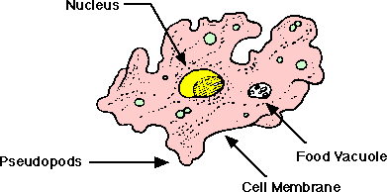
NUTRITION IN AMOEBA
Amoeba is mostly found in pond water .
Amoeba eats tiny plants and animals as food which floats in water in which it lives.

Slide 19
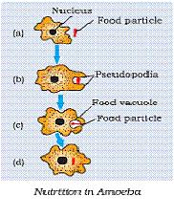
NUTRITION IN AMOEBA
Amoeba ingests food by forming temporary finger like projections called pseudopodia around it.
The food is engulfed with a little surrounding water to form a food vacuole.
The food is digested in the food vacuole by digestive enzymes.

Slide 20
THANK YOU

